Slide 1


POWERSKATE PARENT MEETING
Important highlights
POWERSKATE INFORMATION & REPORT CARDS…..WHERE TO FIND IT
HEALTHY KIDS! ACTIVE KIDS!
STORM DAYS
EVENTS

Slide 2
Welcome to POWERskate
Are you new to POWERSKATE? Welcome to SPSC
If you are returning… Welcome Back
For any not aware
Chanda Bissett is our Club President
And Laurie Godfrey is the Club Administrator
You can reach any of our board or coaches through our office email office@sherwoodparkdaleskatingclub.com or go to our Contact us page for individual contacts or direct link to our club address
Jessica Godfrey & Deonna King are the Powerskate Coaches

Slide 3


Where to find things

Slide 4
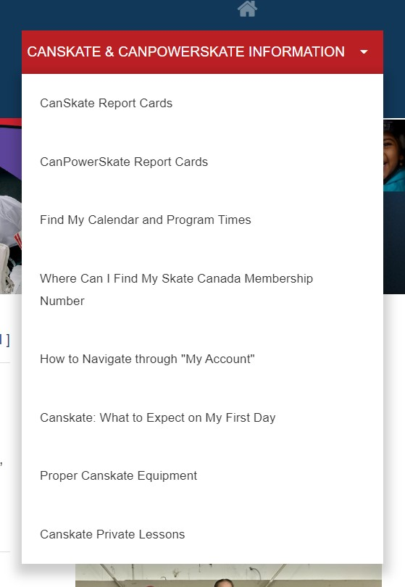
How to find things
Drop down menu

Slide 5
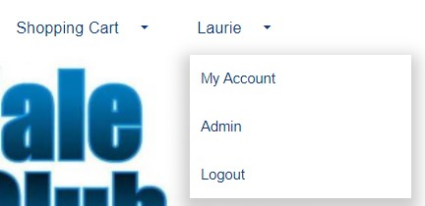
Your Account
To find a lot of information from our “How to Info”, you need to be logged into your account
  Once logged in go to the upper right corner where you will see your name
  Click on my account from the drop down when you hover over your name
  Once in “my account” you will have a menu bar specifically for you.
THE CALENDAR tab in your account
  will show all your registered skating days, events etc. A non-skating day may show a tournament instead of your regular skating time. These were pre-scheduled. You were not charged for these days in your registration fee, there are no make-up days.
  This is the best “go-to” as it shows your registered session times. It the event of any changes, it will show here first.
There are other items such as evaluations, achievements, copies of your invoices…explore your account!

Slide 6
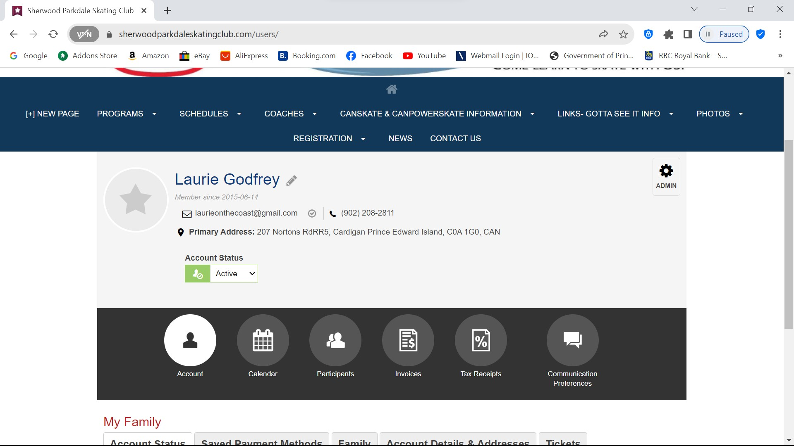

Accessible in your personal account

Slide 7
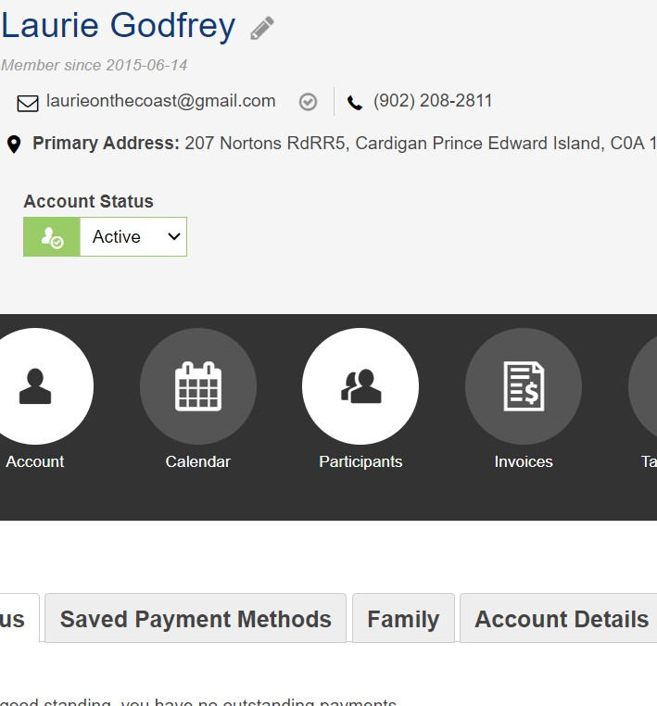
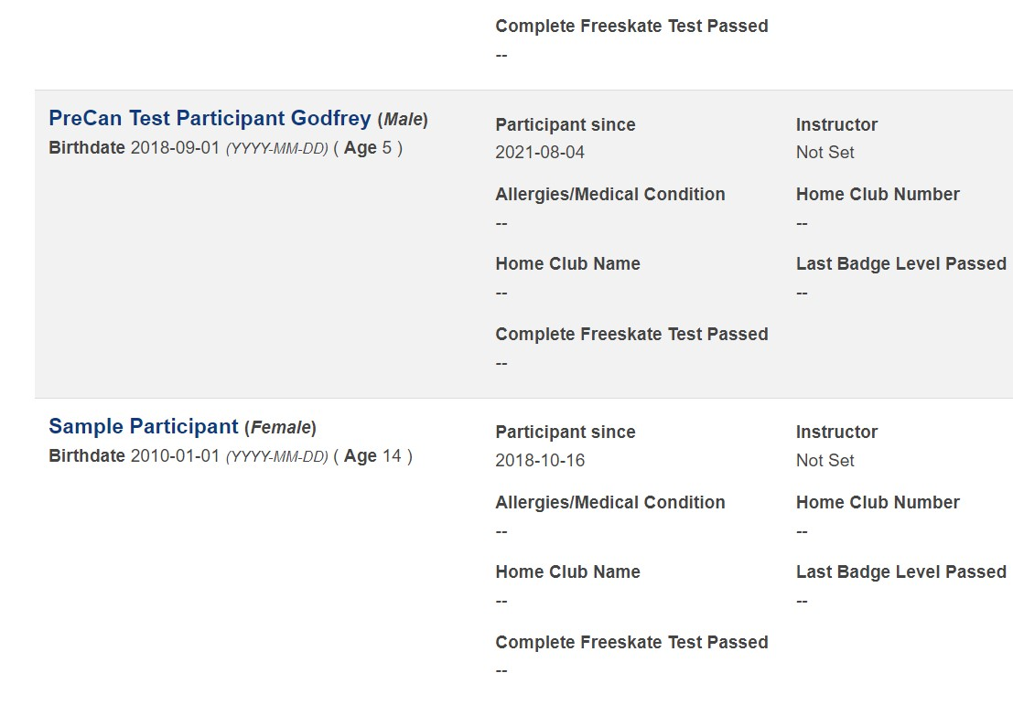
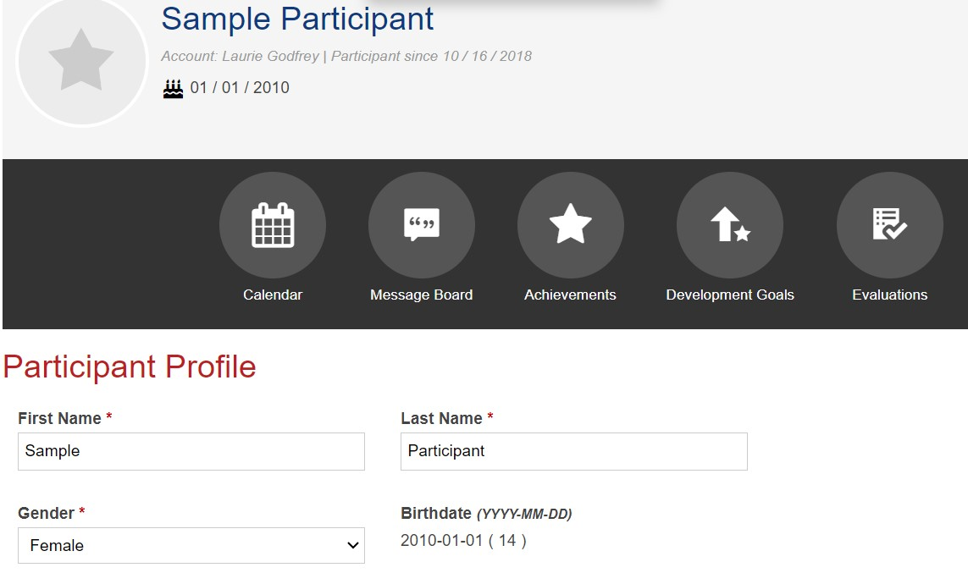


3 – view achievements and evaluations
1 - Click on Participants
2 – Select Participant
FROM WITHIN YOUR ACCOUNT – SEE YOUR PARTICIPANTS PROFILE

Slide 8
Notices
STORM WATCHES AND CLOSURES – in the event of storms or unforeseen closures, we will post on our website as well as send you an email. We normally only close if the facility is closed. Therefor if you see from a community posting that the arena is closed, then so are we. There is the off-chance if our administrator does not have power, they will not be able to email you. Please don’t call the arena as they are not part of our operation for detailed info.
Along with sending email we also have a bulletin board in the lobby where we will post updated information, special events and more. Check it out once-in-a-while for new information.

Slide 9
PROGRAM Specifics
SPSC runs the updated approved Skate Canada Powerskate Program.
There are varied levels of skaters on the session
  Early Stage of Development
  Moderate Stage of Development
  Advanced Stage of Development
Skaters will work in a group format on varied skills with different targeted expectations to achieve the quality required at their stage of development.
NEW – includes and off-ice component

Slide 10
Coaching Staff
There will be up to two professional NCCP certified coaches on the ice.
Assisting them are our Program Assistants.
  Program Assistants are experienced skaters from a hockey and/or ringette background

Slide 11
Healthy Kids! Active Kids! Fundraiser
Our Main Club Fundraiser
This is not mandatory however we are asking all Canskaters and Powerskaters to consider purchasing at least one item.
We have been hit hard with increased operating expenses from all areas this season ie ice costs, insurance, coaching, supplies etc and we DO NOT want to pass these increases off to you by increasing registration fees. Sports are expensive enough for families and we would rather put food on your tables than increase fees.
New partner “Mike’s Queen Street Meat Market”
If you are keen and you purchase more than 10 items, you will receive a credit on your personal account as well as helping the club overall.
Extra order forms are available. We will also email out a copy for printing or using digitally.

Slide 12

We are always looking for volunteers
This can be during your scheduled skating time only
or at special events
or if you love our skating community, we always could use someone new on the board.
Help us build your program in your club!

Slide 13
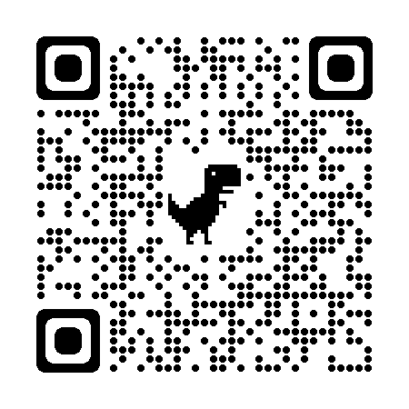
Club Apparel
We have a store available through Allstar Cresting
  There are t-shirts, hoodies, outdoor jackets and more – Get in the spirit with quality merchandise. 10% goes to the club.
Here at the club, we also have mittens/gloves and a limited supply of skate guards for sale
Club competition/practice jackets are orderable through the club. Reach out to us at office@sherwoodparkdaleskatingclub.com if you are looking for an on-ice jacket. You can follow this link to our Allstar Store. This is also posted on our bulletin board.

